Slide 1
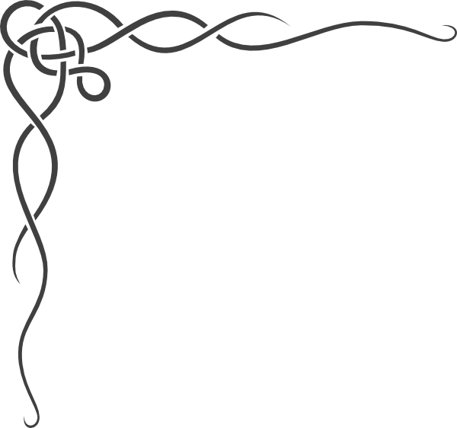
Origins of the Celts

Slide 2
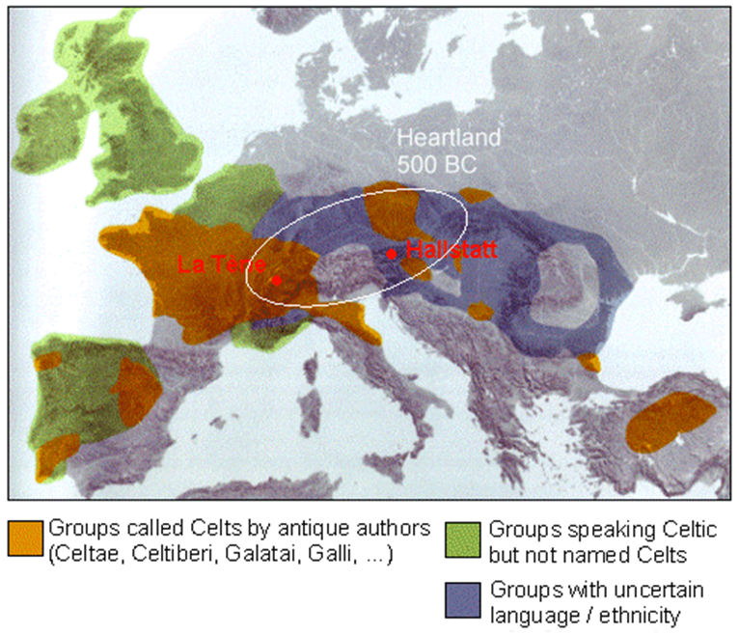
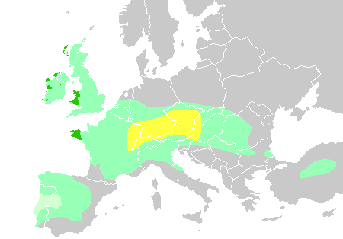
Time: 6th century B.C. (give or take a century or two)
Roman & Greek texts
Archaeology
• Place: central Europe, upper Danube
www.tf.uni-kiel.de/matwis/amat/iss/kap_a/advanced/aa_3_1.html

Slide 3
We get the word “Celt” from what the Greeks & Romans called the people of the time: Keltoi. There is no evidence of that people calling themselves Keltoi.
The Greeks & Romans considered the Keltoi to be a barbaric people. According to ancient texts, they enjoyed warfare, and they certainly practiced it a great deal:
Haywood, John. The Celts : Bronze Age to New Age http://ebookcentral.proquest.com/lib/gordonstate/detail.action?docID=1733985
Note that there was a warrior class; “warrior” was not the only occupation, although it was probably, for its time, equivalent to our professional sports star or film star class.
Celtic society was dominated by a warrior elite. For them warfare was essential, both as a theatre in which to perform status-enhancing acts of valour, and for the spoils, which when distributed enhanced the status of a leader, attracted more warriors into his retinue, and so made even larger-scale and wide-ranging raids possible. Ambitious leaders had also to compete with one another for status and followers, reinforcing the warlike tendency of Celtic society. If the opportunities for raiding were restricted for some reason, the competitive nature of warrior society might turn inwards.

Slide 4
Early Celtic/Keltoi Society
Basic Structure
The basic structure of the early Celtic society is one that is familiar to us from books & television: the clan. When a man died, everything, including his land, was divided among his sons, & each son set up his own household on his portion, so families remained together. Each clan was, for the most part, self-sufficient & didn’t have to rely on trade for what was needed.
Slaves were also part of this society. They were captured from among peoples raided by the warrior class. Those who reached middle age were sometimes freed & even given a portion of land, & their children became part of the clan.
Incidentally, St. Patrick, hundreds of years later when the Keltoi had migrated,
was taken to Ireland from modern-day England as a slave.
Fosterage was another institution practiced by the Keltoi; children of higher class households were sent to lower class households for training & instruction. This strengthened bonds within the clan (and sometimes across clans), & it also allowed fathers to put their children out of harm’s way if there were jealous rivals.

Slide 5
Religion
First, a disclaimer:
The archaeology … reveals an enormous degree of regional diversity […] which make[s] it problematic to make rough generalisations of ‘Celtic’ or native beliefs on the basis of isolated finds from different parts of Western Europe. Moreover, religions (i.e. religious belief systems) are not static but constantly evolving (Ralph Haussler, “From Tomb to Temple”).
In short, when you’re talking about millions of people & millennia of time, you really can’t say, “This was their religion.” What we’re looking at here is the predominant religious beliefs of the earliest Keltoi that are attested.
The Keltoi probably believed, as did many cultures, that the sky was held up by pillars, sometimes represented by trees. The tree is often considered sacred in pagan societies throughout history. Like the Greeks & Romans, they had a pantheon of gods. Unfortunately, the Roman and Greek writers, from whom we learn much about Keltoi religion, had a tendency to assign Roman/Greek names to the Keltoi gods. For example, Mercury was supposedly the most revered god, but the Keltoi didn’t have a god named Mercury. However, a study of various inscriptions & other evidence from Keltoi society indicates that their name for their god was “Lug,” & forms of that word can be found in some modern-day place names (e.g., the Spanish city of Lugo).

Slide 6
We know from the more familiar Greek & Roman mythologies that deities were associated with nature (e.g., Apollo was god of the sun, Poseidon/Neptune was the god of the sea, there were sea & wood nymphs, etc.). In early Roman times, a cult of worship called Mater Magna (the Great Mother) spread from a kingdom called Phrygia, located in what is now Asian Turkey. The cult reached Greece first, & the Greeks identified the goddess as Rhea, mother of all the earth & all the gods. In Roman mythology, she is called Ops. (Their spouse/s, Cronus & Saturn respectively, are, ironically, more familiar to us.)
Although we know that the Great Mother cult spread to the Keltoi, she was worshipped under different names. Some possibilities are Onuava and Danu (who is still familiar to those who study Irish mythology), & some characteristics of the Great Mother are evident in the Celtic goddess Brigid. Brigid, in turn, blends in with one of the patron saints of Ireland, St. Brigid of Kildare, who lived around the year 500 A.D.
There are many references to “triple goddesses,” where the three form one, with each representing a different aspect of some virtue/ideal/concept. However, virtually all of those (see “Morrigan” if you’re interested) for which we have solid information actually appear in more “modern” times (i.e., around the time of the birth of Christ & later).

Slide 7
The earliest Celts (late Bronze Age) cremated their dead, placed the remains in an urn, & buried the urn in a cemetery (or Urnfield) with hundreds or thousands of others. One such cemetery discovered in modern-day Germany contained over 10,000 urns. Their burial practices, which eventually replaced cremation during the Iron Age, indicated a belief in an afterlife, because they were buried with all sorts of weapons, tools, & ornaments. (The change in what was done with human remains may indicate a change in beliefs.)
It’s fortunate for us that they buried a variety of objects with their dead, because those graves have allowed us to learn a great deal about their society in general & their art in particular. As we’ll see later, the art of one particular period has come to be a huge part of what we consider to be “Celtic” today.

Slide 8
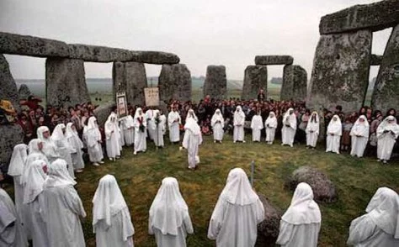
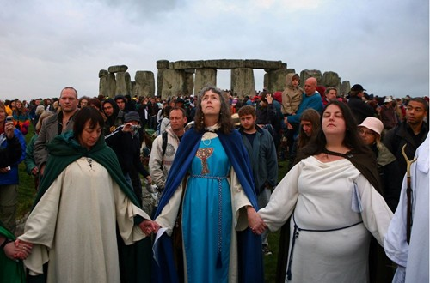
Druids
Druids are almost a modern myth unto themselves. We imagine men in robes & hoods holding secret rituals. In fact, so-called Neo-Druidism is a manifestation of what people imagine the druids to have been, & the pictures below are of Neo-Druidic ceremonies at Stonehenge.
Don’t be deceived into thinking that Neo-Druidism is a continuation of ancient druidism; ancient druidism died out as Christianity spread across Europe, & Neo-Druidism began in the 1900s.

Slide 9
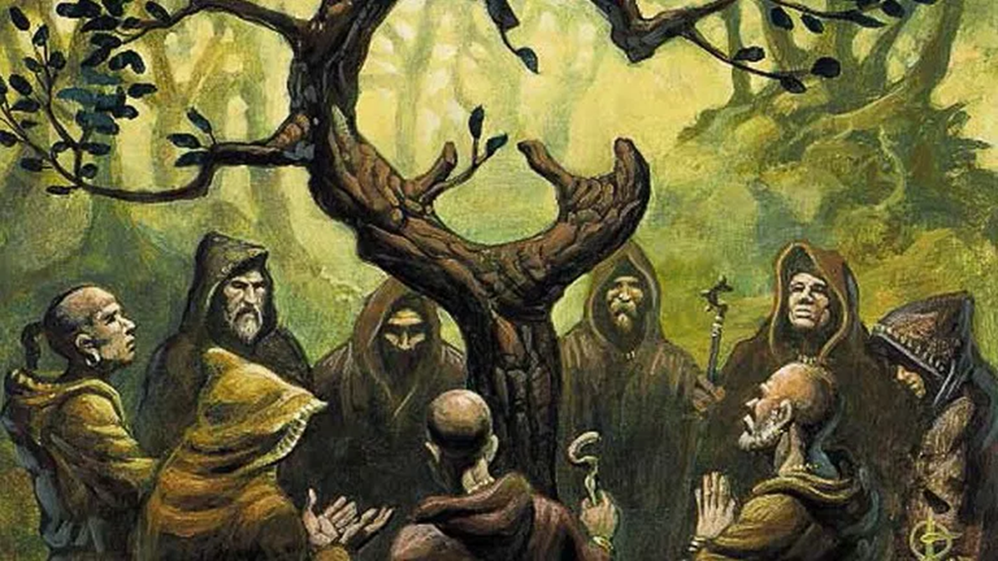
Unfortunately, we actually have very little
knowledge of the ancient druids. The Roman
writer Dio Chrysostom, born about 40 A.D.,
stated that “Celts appointed those whom they
call druids, these also being devoted to the
prophetic art and to wisdom in general.” They
were pagan priests, but they were also teachers, philosophers, counselors, & judges.
The word “druid” derives from a Celtic
compound that means “oak” and “knowledge.”
Mara Freeman states that “many early Christian churches were situated in oak-groves, probably
because they were once pagan places of worship” (https://www.druidry.org/library/trees/tree-lore-oak). The original name of Derry in Northern Ireland
came from the same word as “druid,” and St. Columba, one of the 3 patron saints of Ireland, founded a church in an oak grove there. Throughout the Old Testament there are mentions of groves & high places, & without exception they are associated with paganism, & the Jews (children of Israel) were commanded to tear down those places.
Pliny the Elder, in the first century A.D., recorded that Druids had a ritual that involved climbing oak trees to cut down mistletoe. They then sacrificed two bulls and mixed the mistletoe into a potion that was supposed to bestow fertility & serve as an antidote to poison.
Druids believed in and taught reincarnation. This would seem to be at odds with the evidence from cemeteries, where we’ve found objects intended for the dead to take into the next world, but Druids seemed to have believed that the dead sometimes spent time in the “otherworld” before returning to this one.

Slide 10
You may have heard of the wicker man, particularly since it’s the name of a movie that ends with the burning of a wicker man. There is some disagreement about whether this practice actually existed, but Strabo, a historian born around 64 B.C., wrote that the druids, “having devised a colossus of straw and wood, throw into the colossus cattle and wild animals of all sorts and human beings, and then make a burnt-offering of the whole thing.”
To put it plainly, the druids made a huge man of wicker (straw, sticks, branches, etc.), put inside it animals and humans, and then set it on fire as a sacrifice. Julius Caesar wrote that the druids made “figures of vast size, the limbs of which formed of osiers they fill with living men, which being set on fire, the men perish enveloped in the flames. They consider that the oblation of such as have been taken in theft, or in robbery, or any other offense, is more acceptable to the immortal gods; but when a supply of that class is wanting, they have recourse to the oblation of even the innocent.” Some scholars take issue with Caesar’s words, first because Caesar himself did not observe the ritual firsthand and second because the Romans were frequently at war with the Celts, whom they considered, remember, barbarians.

Slide 11
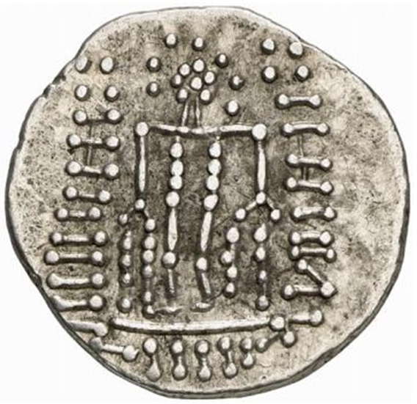
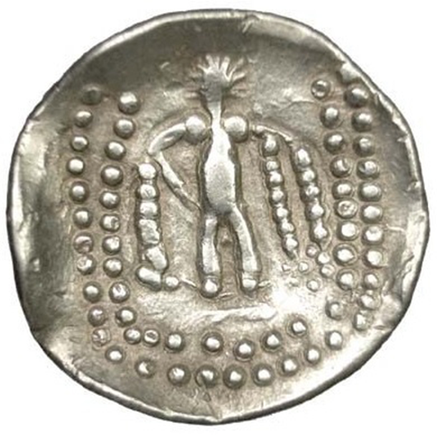
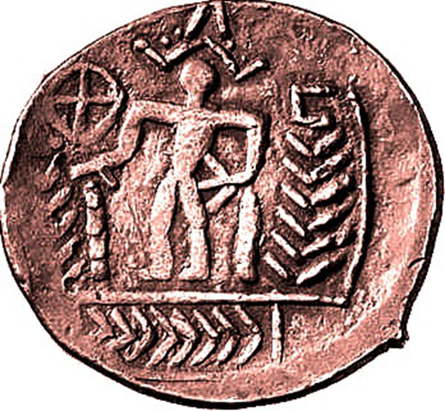
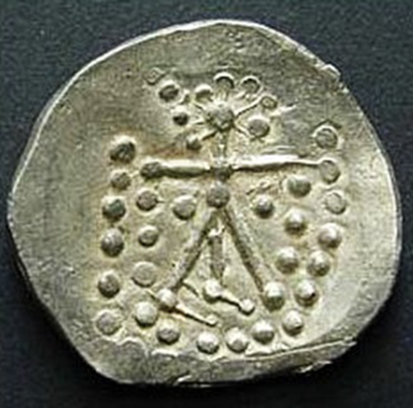
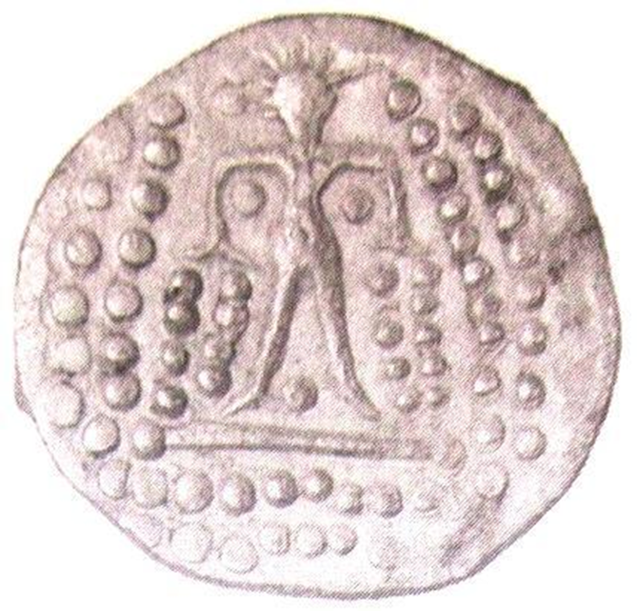
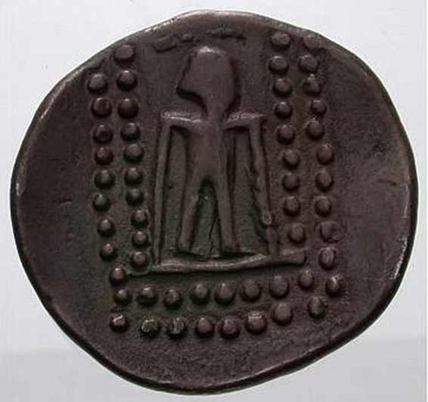
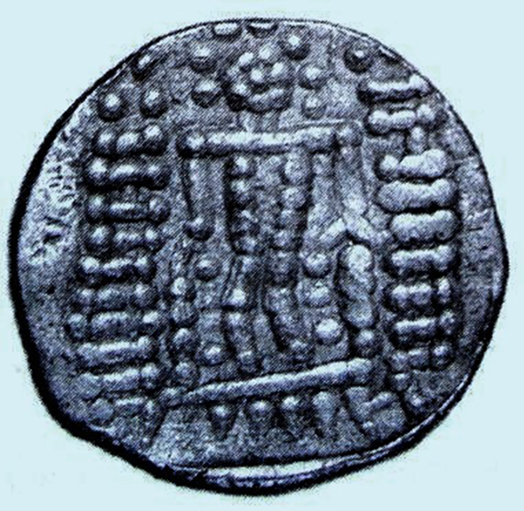
Interestingly, archaeologists have discovered Celtic coins with images of what could be a wicker man.
https://balkancelts.wordpress.com/2013/10/05/the-wicker-man/

Slide 12
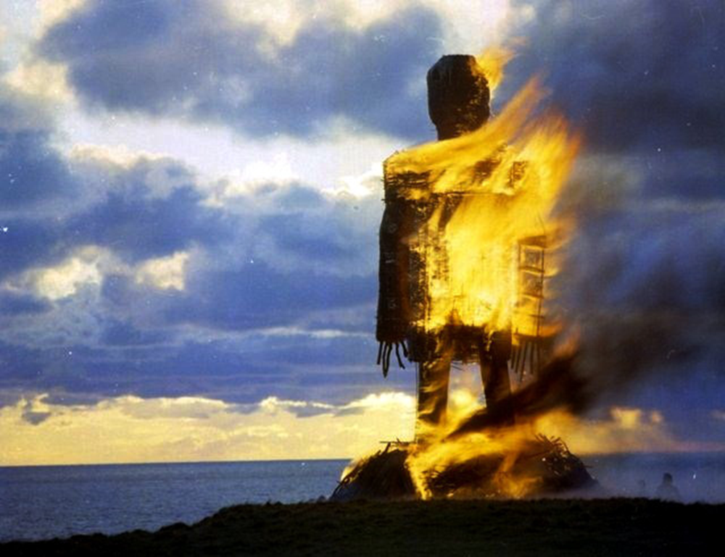
This picture is not of an actual druidic sacrifice.

Slide 13
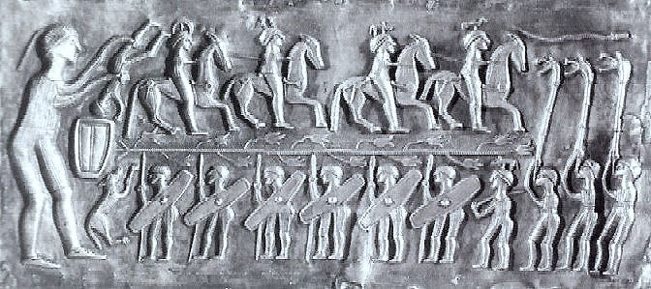
Burning was apparently not the only means of sacrifice. The picture below is from the Gundestrup Cauldron (between 2nd & 1st centuries B.C.) showing a ritual drowning.
Just as burning wasn’t the only means of sacrifice, drowning wasn’t the only ritual death. In 1983 the remains of a man from around the time of Christ were found in Lindow Meadow (England), & the man has come to be known as Lindow Man. He was hit on the head and strangled, & his throat was cut. This “triple death” is found in Celtic mythology.

Slide 14
Next we’ll look at the archaeological discoveries that are most significant in developing a knowledge of the Celts.

